Slide 1


Optimal Starbucks Locations
Drazen Zack
Ankur Patel
Paul Kegelman

Slide 2
Introduction
Find optimal new Starbucks locations in three cities:
Chicago
Philadelphia
Manhattan
Create a model to identify the optimal new locations
Train on two cities and test on unused city

Slide 3
What is a census tract
Small, relatively permanent statistical subdivisions of a county
Roughly equal to a neighborhood in size
Larger than a block
Population of a census tract ranges between 1,200 to 8,000 people
74,134 tracts defined for the 2010 census in the U.S. and its territories
We are in census tract 34017002800 or Census Tract 28
34 = State of New Jersey
017 = Hudson county
002800 = tract number

Slide 4
Data Sources
Census Bureau API
Statistics from American Community Survey (ACS)
Demographic data by census tract
Most recent year was 2016
Ridership data
Subway or train system data
Number of people entering/leaving station turnstiles
Chicago – transit website
Philadelphia - Southeastern Pennsylvania Transportation Authority website
Manhattan – MTA website
Starbucks location
Kaggle - February 2017
Store address in Census Tract API for tract information

Slide 5
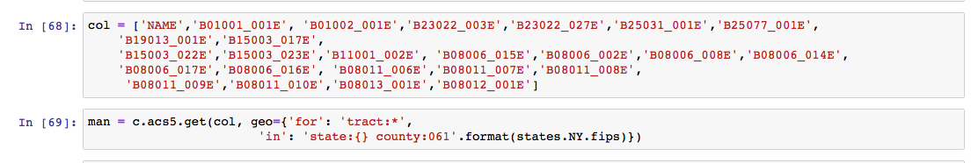
Data Sources Census API
Python library census
Demographic data by census tract
Total population
Median Age
# of Female and Male workers
Median rent
Median home value
Median house hold Income
When people leave for work
How the get to work
Time to work

Slide 6

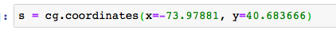
Data Sources Census API
Used python library censusgeocode
Find census tracts for locations of Starbucks in each city
Give the API the address and it gives back census tract
Find census tracts for locations of train/subway stations
Give the API the longitude and latitude it gives back the census tract

Slide 7
Exploratory Data Analysis
Current Starbucks Locations in US
https://public.tableau.com/profile/ankur715#!/vizhome/Starbucks-States/USStates?publish=yes
Demographics of the Census Tracts
Also of Starbucks locations using Census API
https://public.tableau.com/profile/ankur715#!/vizhome/Starbucks-Demographics/Demographics?publish=yes

Slide 8
Model
Logistic regression
Train: 2 cities, Test: 1 city
Predict binary variable (i.e. “No-Starbucks” or “Starbucks”) for each census tract
Probability of a Starbucks being in a census tract
Probabilities were conducted for each census tract for the test city
Top five census tracts that didn’t have a Starbucks were seen as optimal locations
New model each time
Optimal C and penalty found

Slide 9
Predictions
Census Tract | Tract Name | Probability of No Starbucks | Probability of Starbucks
17031080202 | Census Tract 802.02 | 42% | 58%
17031240500 | Census Tract 2405 | 46% | 54%
17031070300 | Census Tract 703 | 48% | 52%
17031071000 | Census Tract 710 | 49% | 51%
17031842300 | Census Tract 8423 | 49% | 51%
Chicago
Philadelphia
Manhattan
Census Tract | Tract Name | Probability of No Starbucks | Probability of Starbucks
42101000801 | Census Tract 8.01 | 37% | 63%
42101000300 | Census Tract 3 | 40% | 60%
42101001202 | Census Tract 12.02 | 41% | 59%
42101000401 | Census Tract 4.01 | 44% | 56%
42101000901 | Census Tract 9.01 | 45% | 55%
Census Tract | Tract Name | Probability of No Starbucks | Probability of Starbucks
36061007800 | Census Tract 78 | 13% | 87%
36061012600 | Census Tract 126 | 18% | 82%
36061008603 | Census Tract 86.03 | 21% | 79%
36061005502 | Census Tract 55.02 | 23% | 77%
36061010800 | Census Tract 108 | 23% | 77%

Slide 10
Observations of Optimal Tracts
Rent,Home Values, and Income much higher than the city average
Higher percentage of people with college degree than other census tracts
Higher percentages of people working
In census tracts right outside of the city’s downtown area
Lots of Starbucks locations in downtown area’s
Areas that Starbucks take advantage of

Slide 11
Predictions Chicago
Census Tract | Tract Name | Probability of No Starbucks | Probability of Starbucks
17031080202 | Census Tract 802.02 | 42% | 58%
17031240500 | Census Tract 2405 | 46% | 54%
17031070300 | Census Tract 703 | 48% | 52%
17031071000 | Census Tract 710 | 49% | 51%
17031842300 | Census Tract 8423 | 49% | 51%
Trained on
Manhattan and Philadelphia
Classification Test
Accuracy of 90%
Observation
Census tracts 802.02 & 8423 have transit stops in them
Census tract 802.02 median age older than than average city census tract median age
All have higher median house hold income, median home value, median rent, percent of workers, percent of people leaving for work between 7 & 9
All have higher percentages of people with either masters or bachelors degree than city mean
801 tracts, 5% people walk to work, and average distance to a Starbucks from the five tracts 276ft

Slide 12
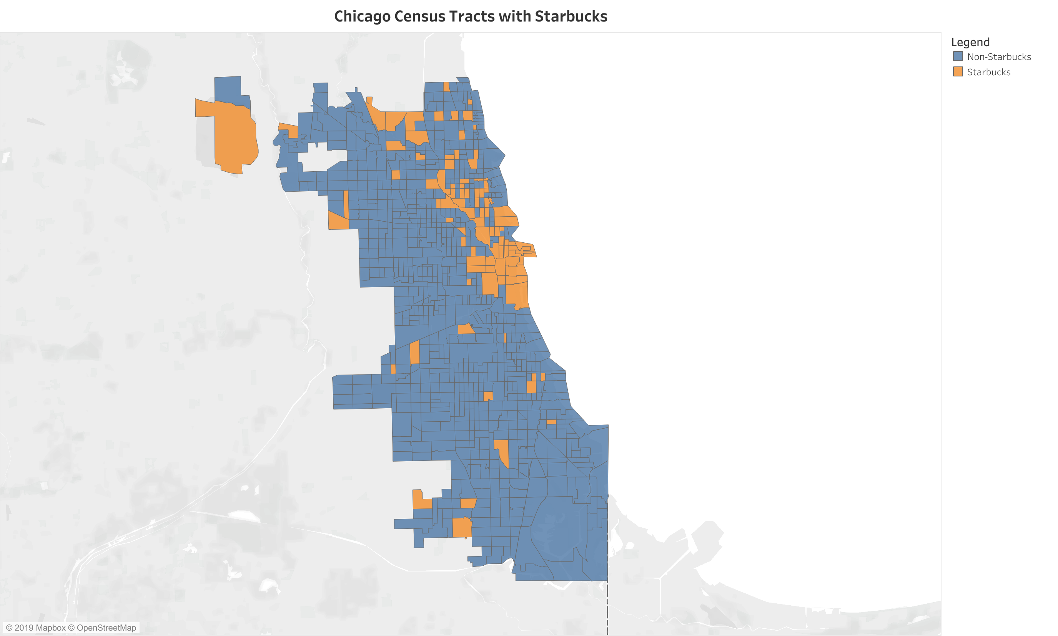
Predictions Chicago

Slide 13
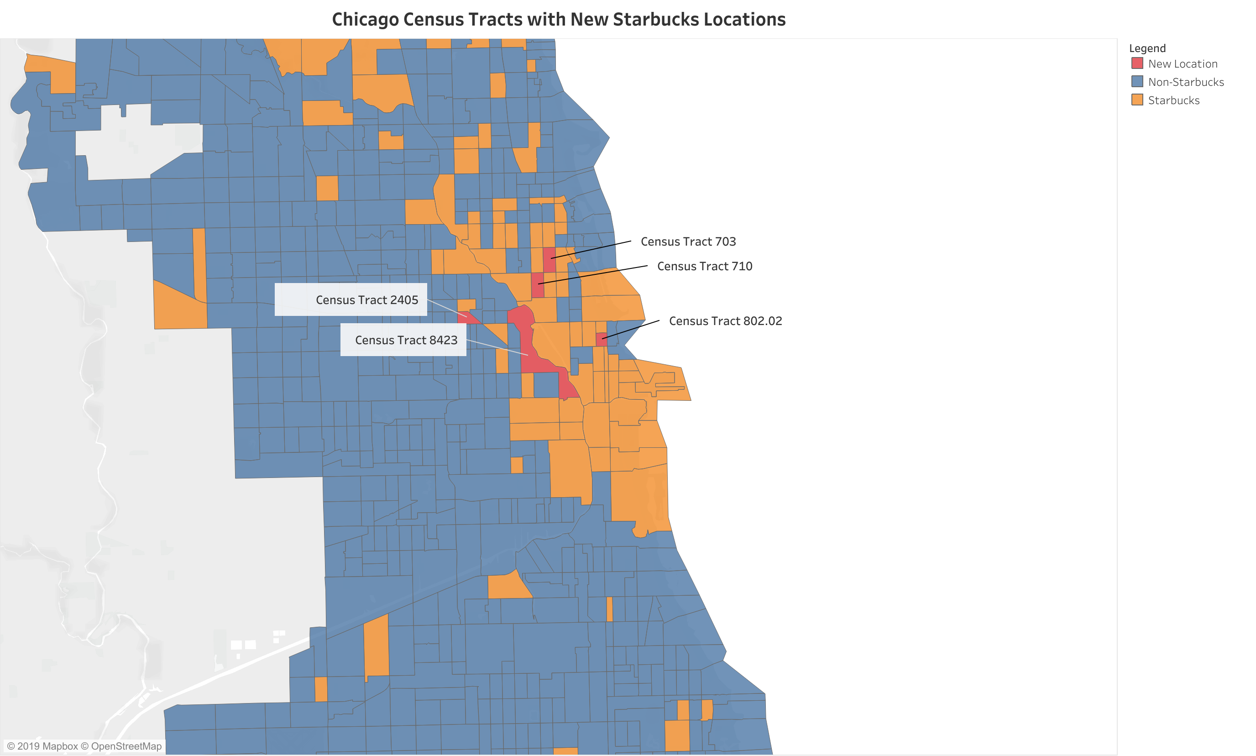
Predictions Chicago

Slide 14
Predictions Philadelphia
Train on
Manhattan and Chicago
Classification Test
Accuracy of 91%
Observations
Census tracts 9.01 & 3 have subways stops
Census tract 12.02 only tract with a total population bigger than the city mean
Census tract 9.01 median house hold income below the city mean
All have median age younger than city mean
All have larger median home value, median rent, percent of workers, percent of people leaving for work between 7 & 9 than city means
All have higher percentages of people with either masters or bachelors degree than city mean
384 tracts, 7% people walk to work, and average distance to a Starbucks from the five tracts 303ft
Census Tract | Tract Name | Probability of No Starbucks | Probability of Starbucks
42101000801 | Census Tract 8.01 | 37% | 63%
42101000300 | Census Tract 3 | 40% | 60%
42101001202 | Census Tract 12.02 | 41% | 59%
42101000401 | Census Tract 4.01 | 44% | 56%
42101000901 | Census Tract 9.01 | 45% | 55%

Slide 15
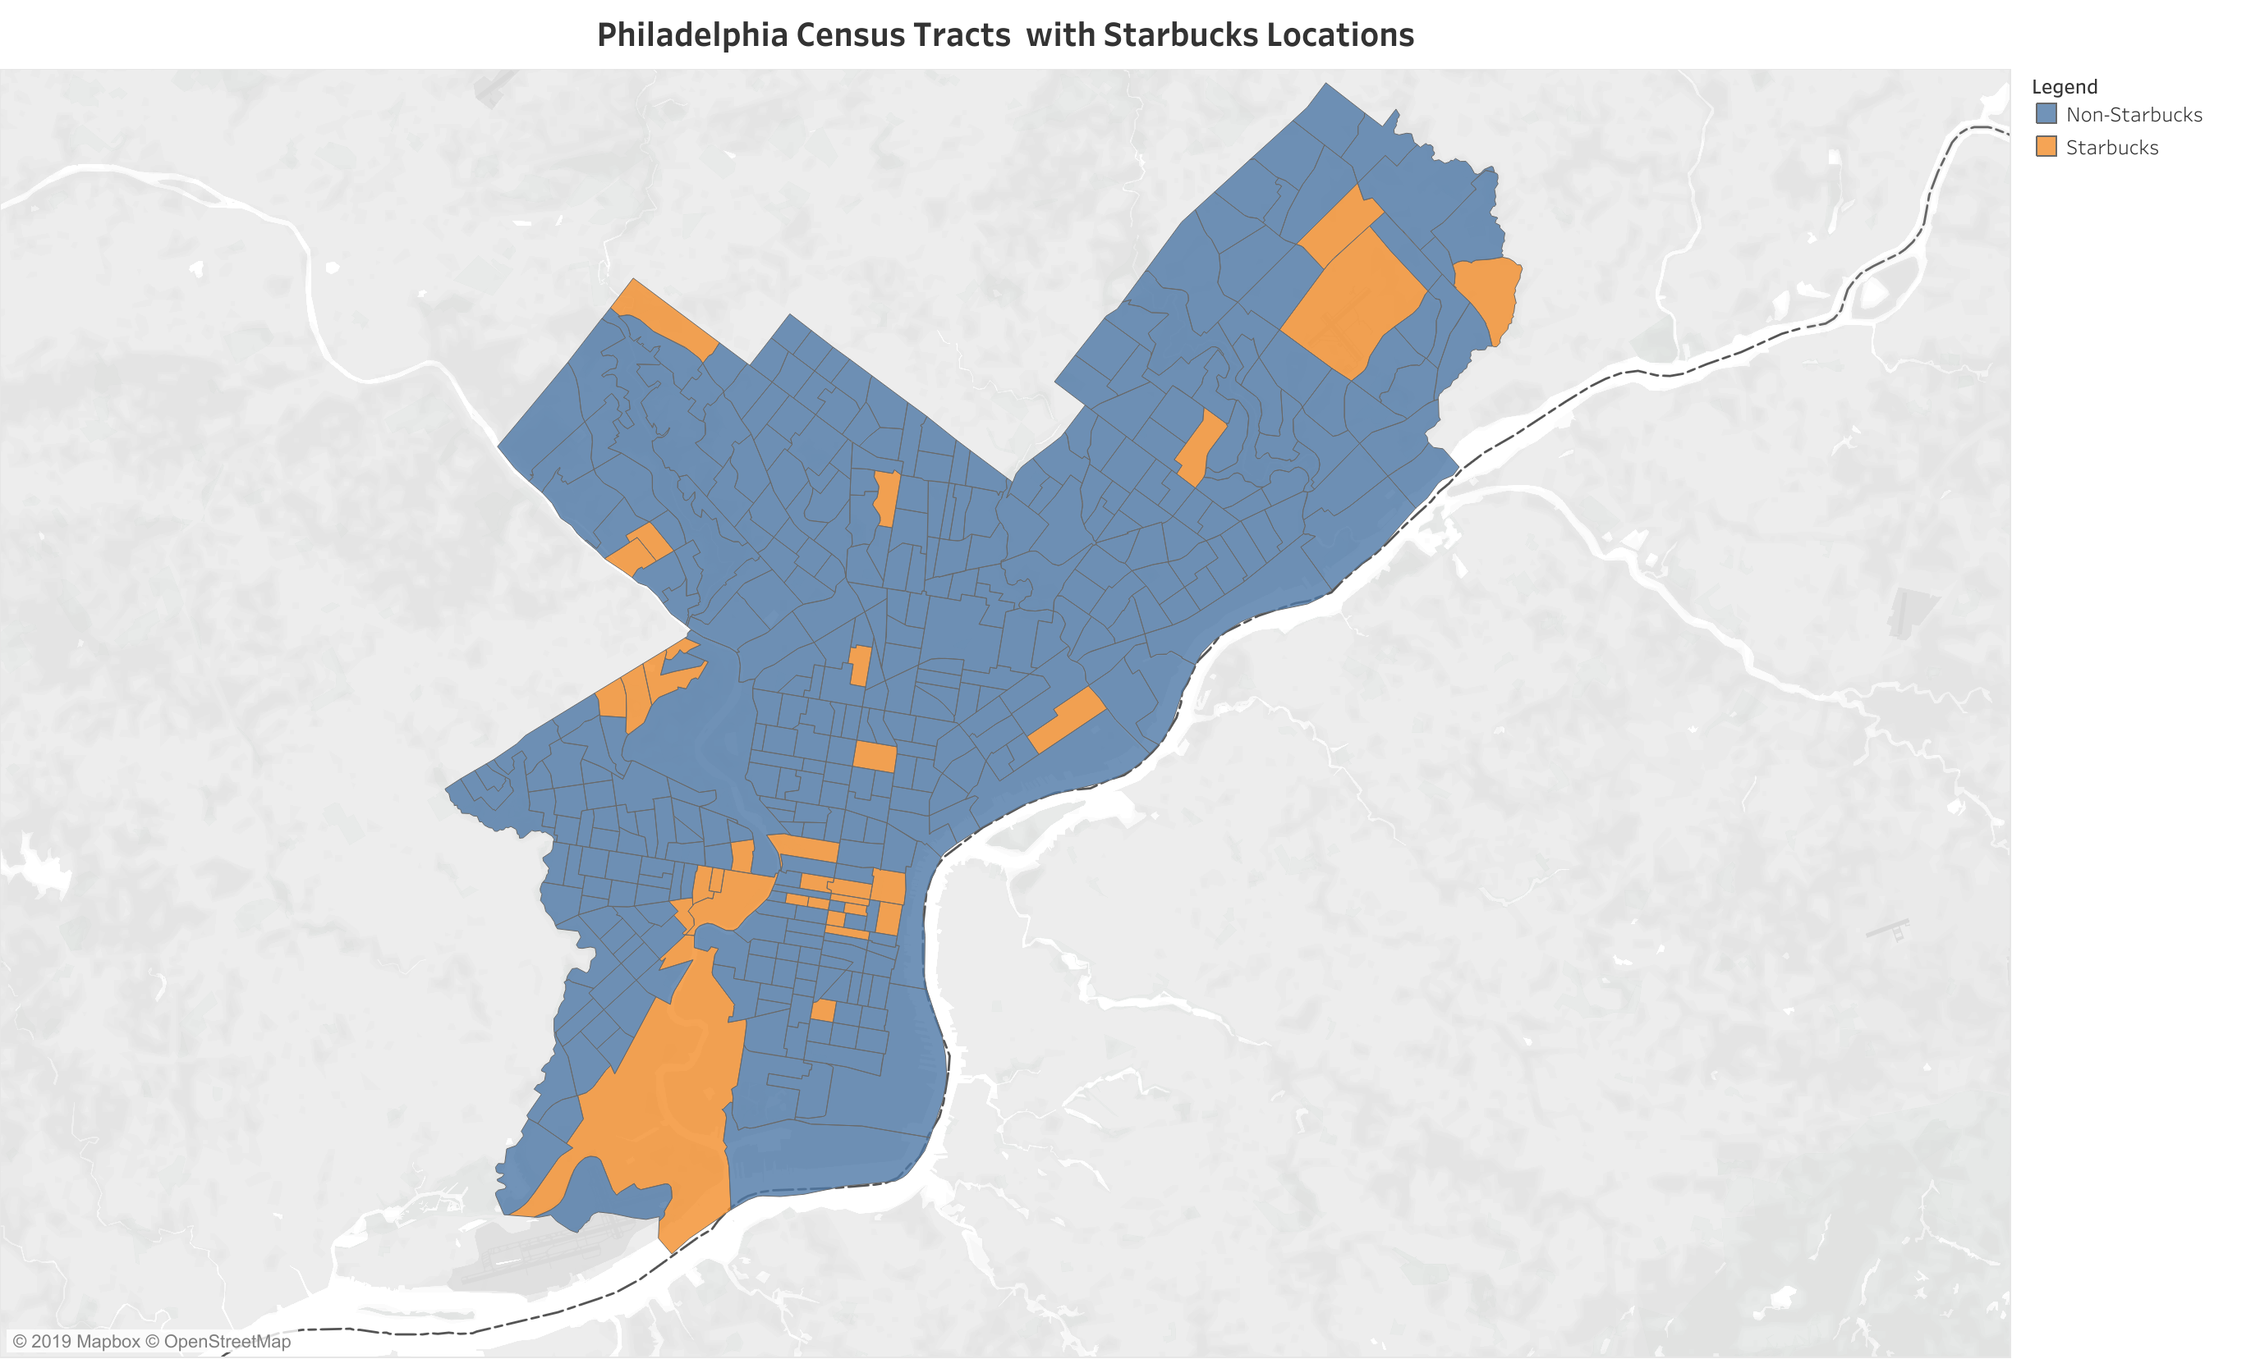
Predictions Philadelphia

Slide 16
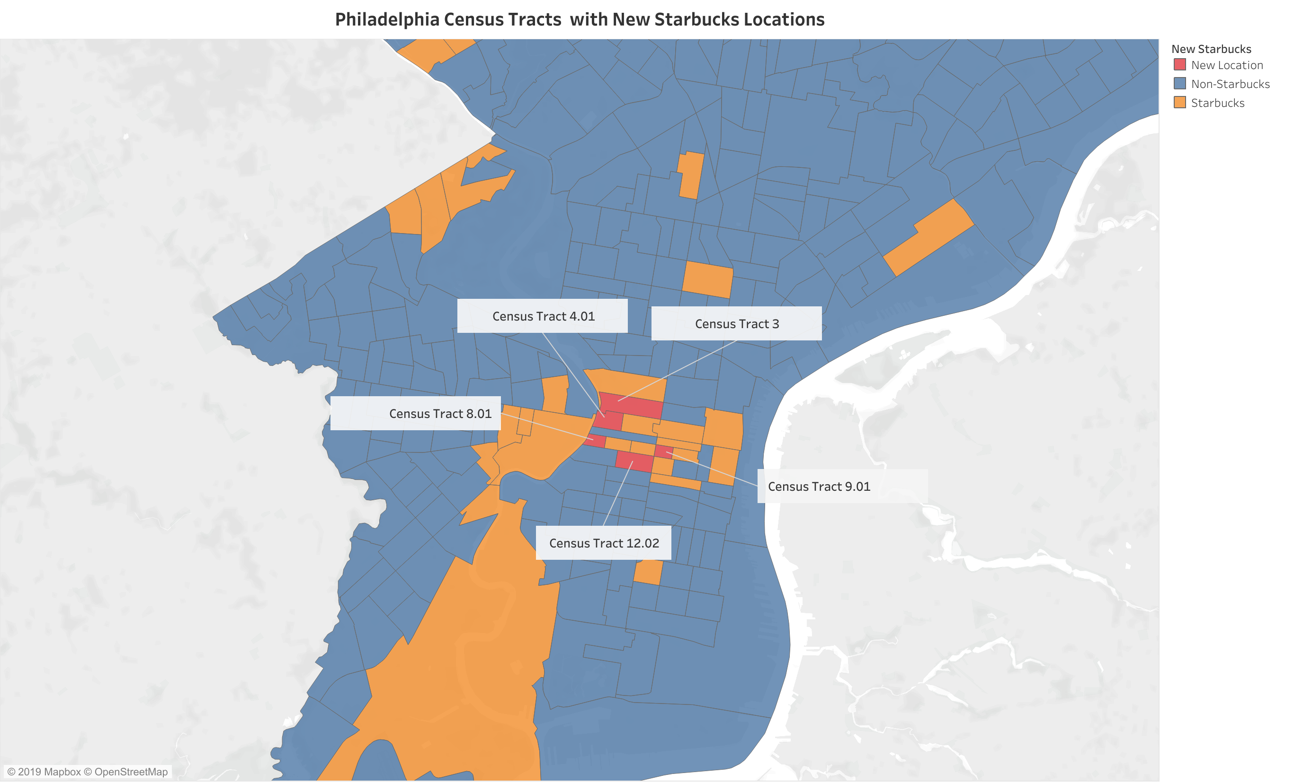
Predictions Philadelphia

Slide 17
Predictions Manhattan
Census Tract | Tract Name | Probability of No Starbucks | Probability of Starbucks
36061007800 | Census Tract 78 | 13% | 87%
36061012600 | Census Tract 126 | 18% | 82%
36061008603 | Census Tract 86.03 | 21% | 79%
36061005502 | Census Tract 55.02 | 23% | 77%
36061010800 | Census Tract 108 | 23% | 77%
Train on
Chicago & Philadelphia
Classification Test
Accuracy 75%
Observations
Census tracts 126 & 55.02 have subway stops
Census tracts 86.03 & 55.02 population less than city mean
Census tract 126 population two & half times the size of city mean
Census tracts 108 & tract 78 lower median home value than city mean
All have higher median rent and house hold income
All have higher percentages of people with either masters or bachelors degree than city mean
288 tracts, 20% people walk to work, and average distance to a Starbucks from the five tracts 194ft

Slide 18
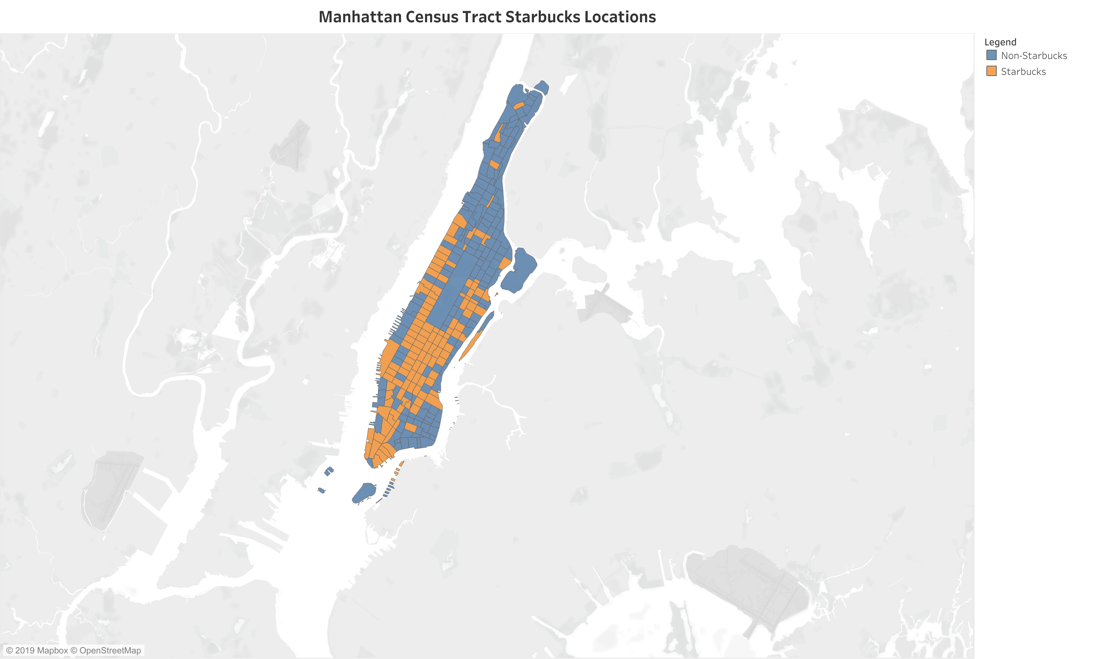
Predictions Manhattan

Slide 19
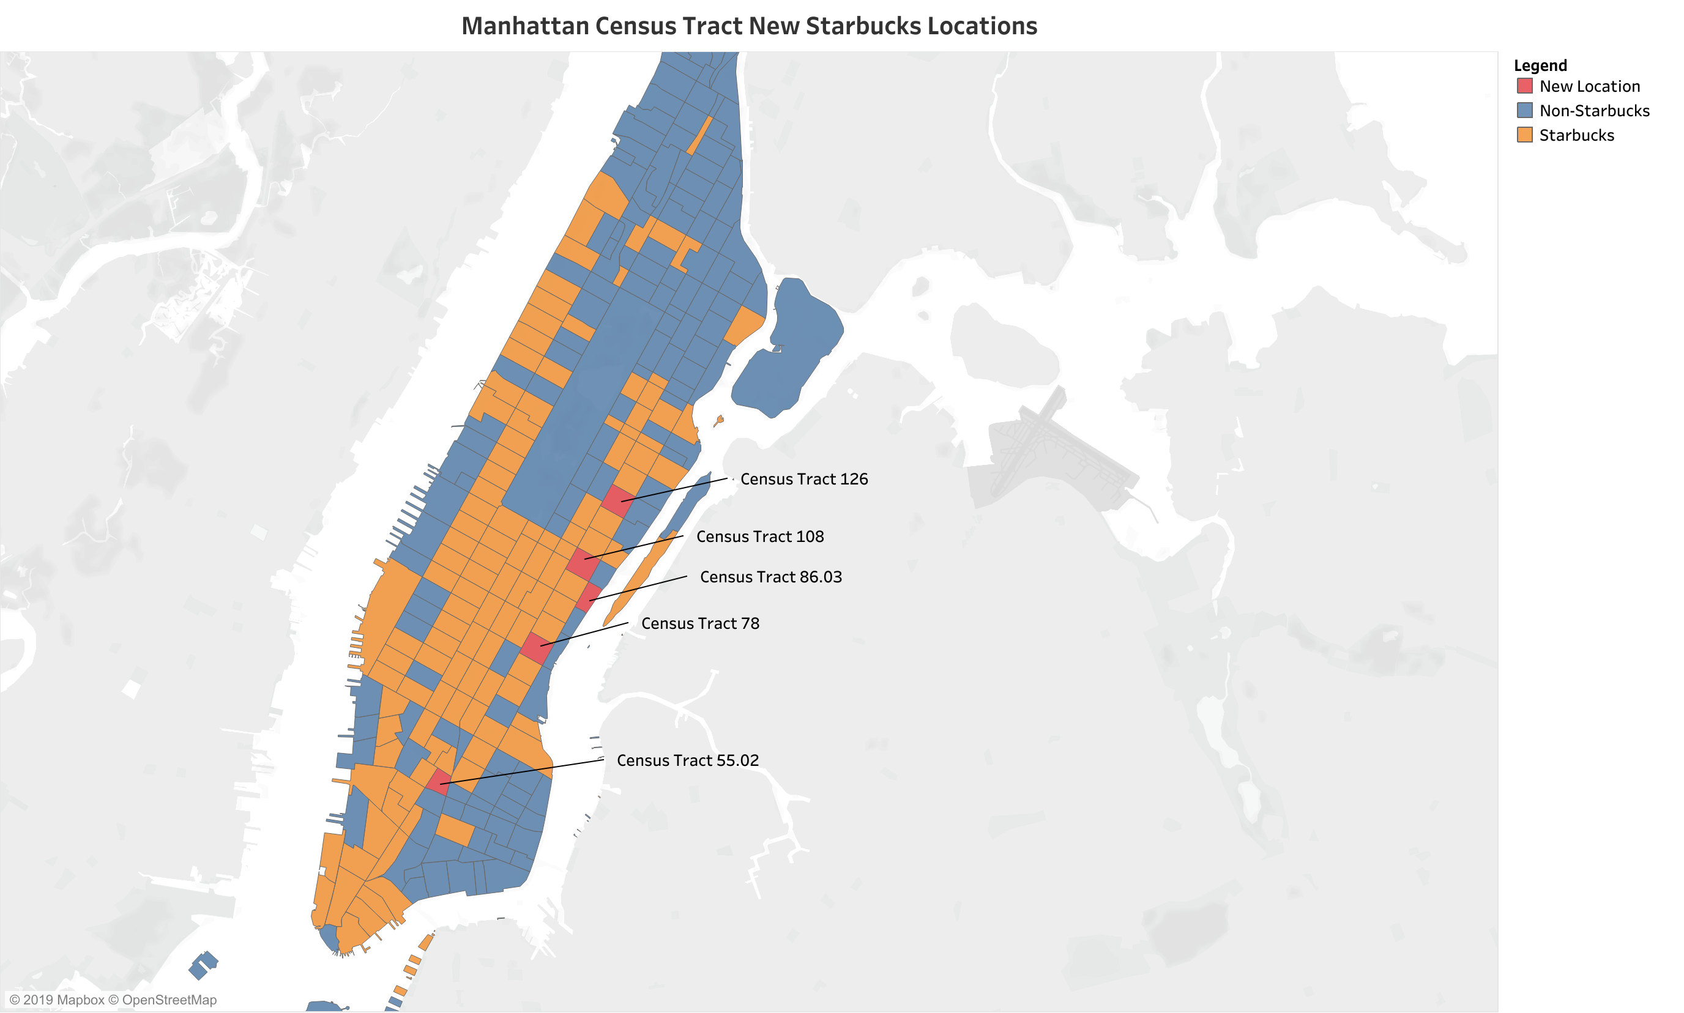
Predictions Manhattan

Slide 20
Future Scope / Improvements
Estimate Census Bureau dataset “NA” values
Complete datasets
Street level traffic
Include factor of competitors
Include commuters that from outside the cities that wouldn’t be included on the census
Include behavioral data of consumers (coffee routine, when, where, how)
Extend to more cities
Huston, LA, D.C., etc

Slide 21

THANK YOU

